Slide 1
Assignment 1 The Banking Organization Systemic Risk Report
Team 7: Sameer,Lipsa,Lalit
(Advances Data Science)

Slide 2
Assignment 1 – Part 1
Goal: Analyzing Banks with asset values greater than $10 Billion
Data Reference: https://www.ffiec.gov/nicpubweb/nicweb/HCSGreaterThan10B.aspx
Requirement: Scraping data for 15 quarters
Coding Language used: Python
Part 1

Slide 3
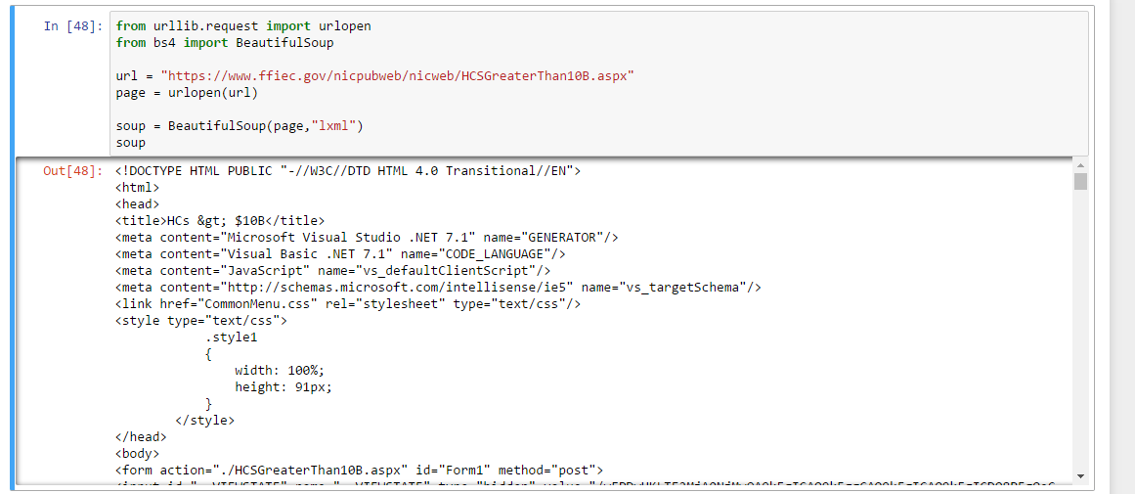
Part 1: Step 1
Fetching HTML content using URLLIB and BeautifulSoup library

Slide 4
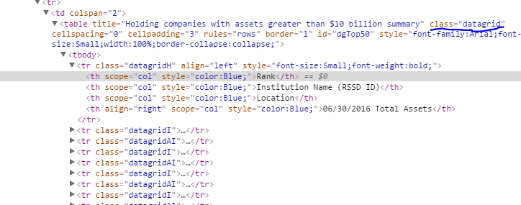
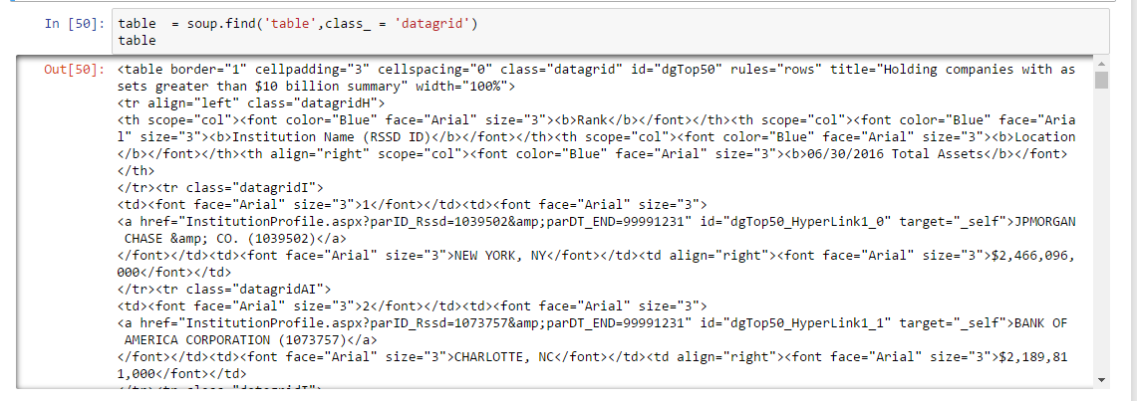
Part 1: Step 2
After inspecting the source code of the page, we find out the table of interest and scrap using the class attribute of it

Slide 5
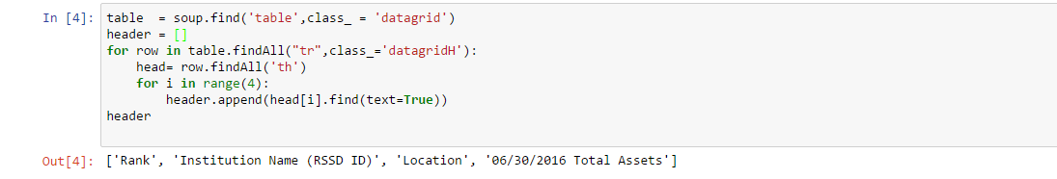
Part 1: Step 3
Fetch the header of the table, using the class of ‘datagridH’ assigned to it and using ‘th’ tag to scrap the header. Finally add in the list

Slide 6
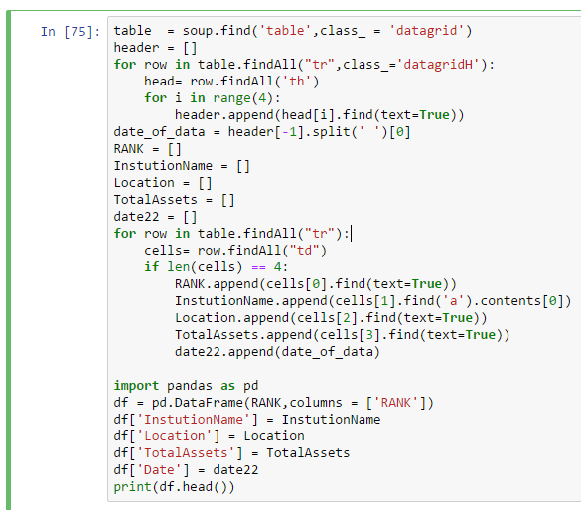
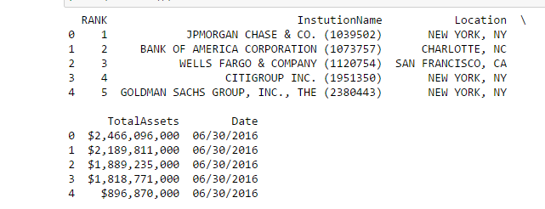
Part 1: Step 4
Repeat the step 3, however now finding the ‘td’ tag to scrap the data inside the table. Also adding an extra date column, whose data is available in the last index of header list

Slide 7
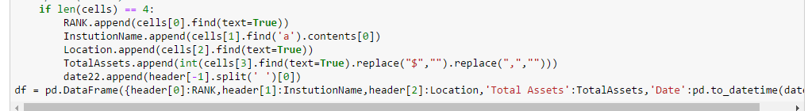
Part 1: Step 5
Now 1st page is scrapped, however the data is raw and needs to be cleaned. For example, ‘$’ to be removed from Total asset and converting it to a integer value. And so on.

Slide 8
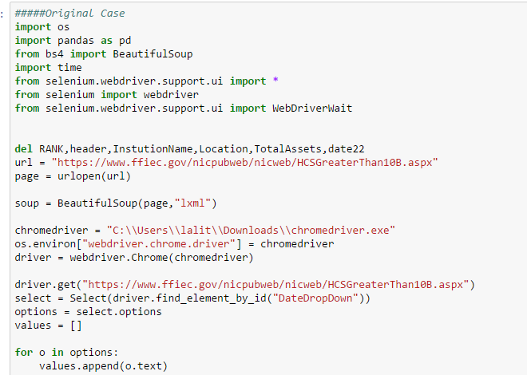
Part 1: Step 6 (a)
Now the data is cleaned and in consistent format for page 1. We will use Selenium webdriver package to interact with the page and select each ‘Quarter’
Here we are getting all the values from the Dropdown of the quarter and loading in an list.

Slide 9
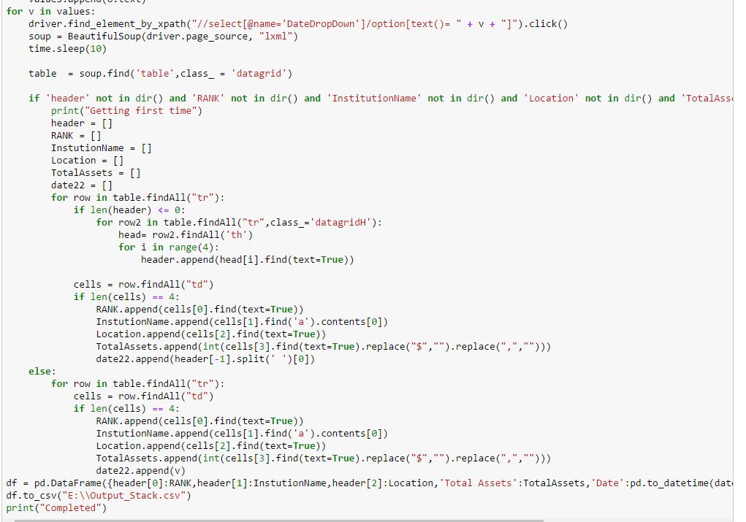
Part 1: Step 6 (b)
Looping through all the values and repeating Step 4

Slide 10
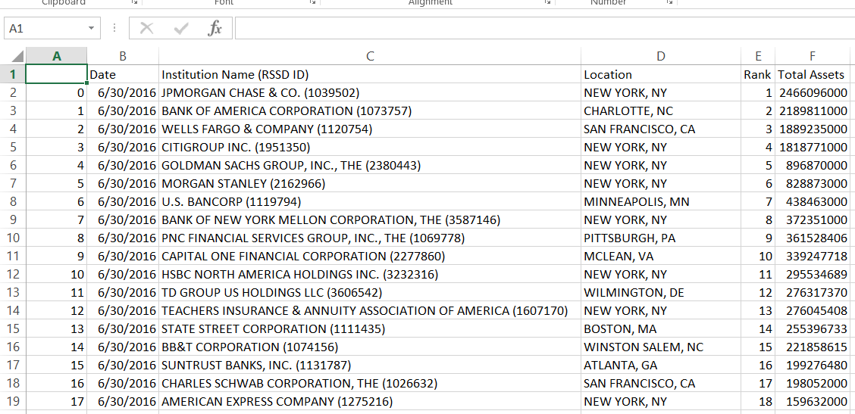
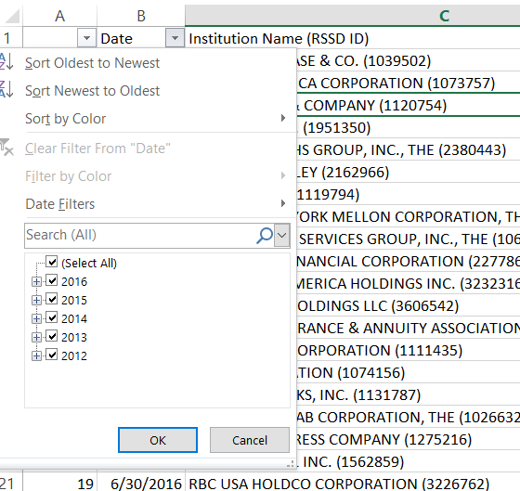
Part 1: Step 7
Final Output as shown below in the csv

Slide 11
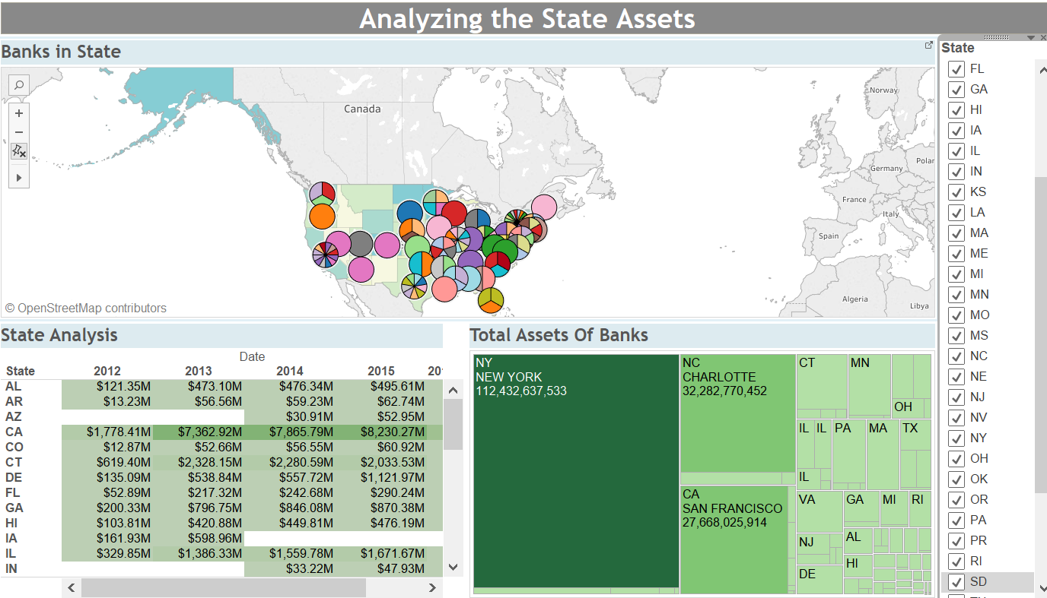
Part 1: Exploratory Data Analysis (BI)
Examining the distribution of total assets across USA with respect to bank over the last 6 years

Slide 12
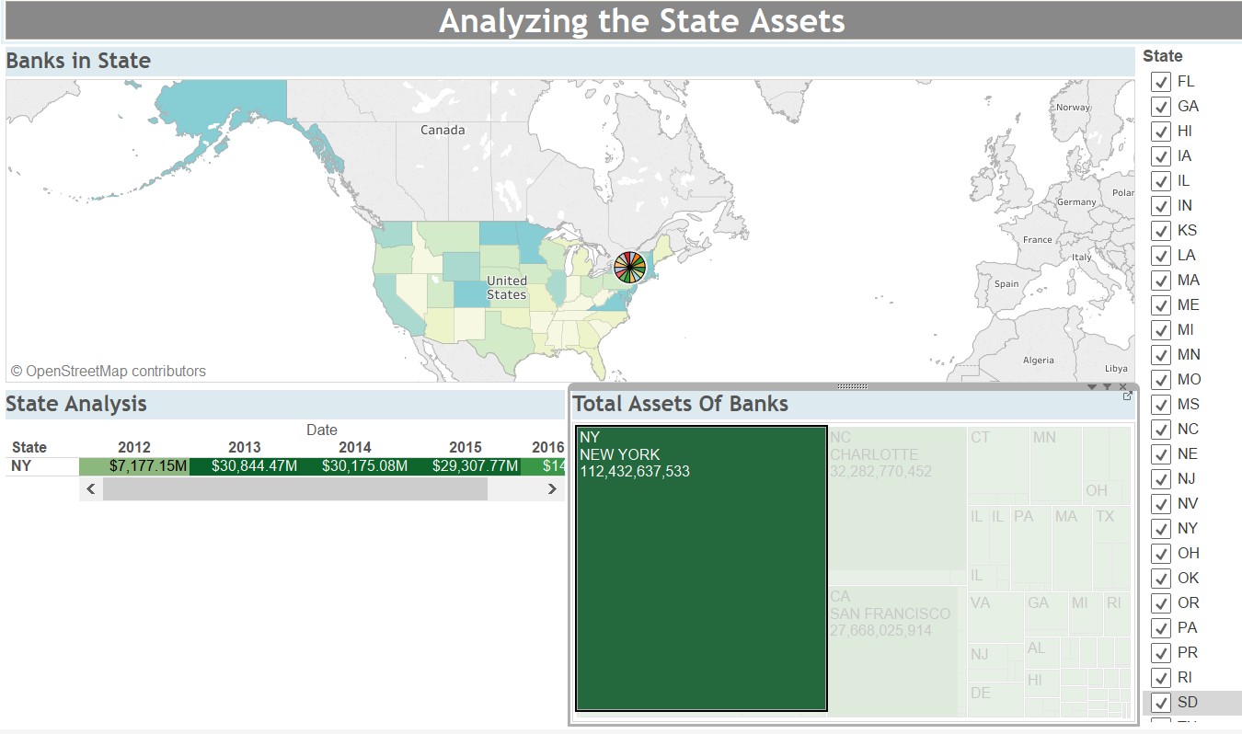
Going a step further..
Drilling through the heat map, it is relevant that why New York City of NY is considered to be the financial hub of USA.
We observed that per capita income is highest in NY and hence the number of banks is also highest

Slide 13
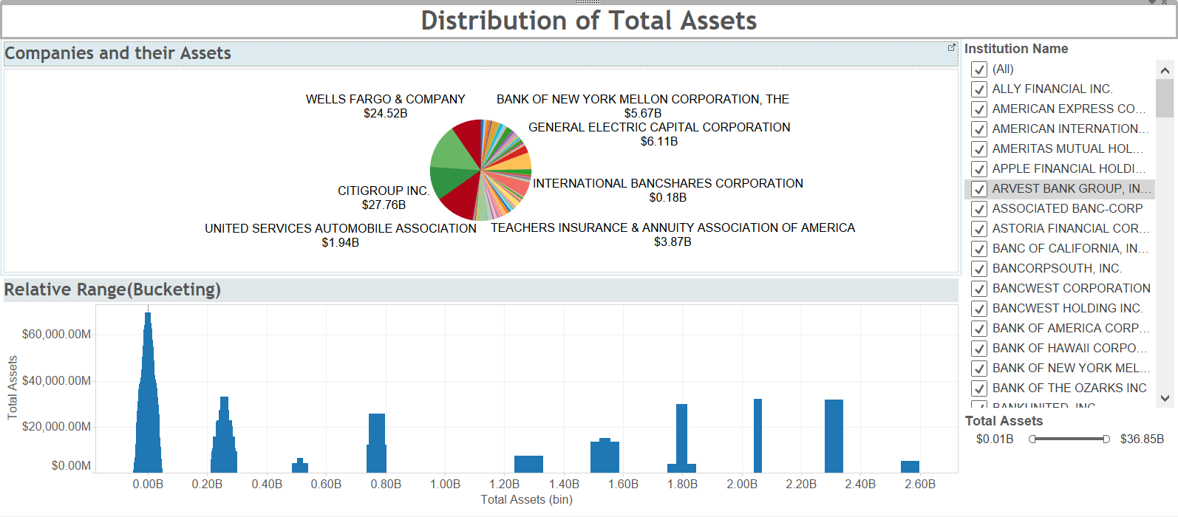
Distribution of Assets across banks
Apart from couple of outliers like J.P.Morgan ($2.57B), majority of the banks fall below 1 billion

Slide 14
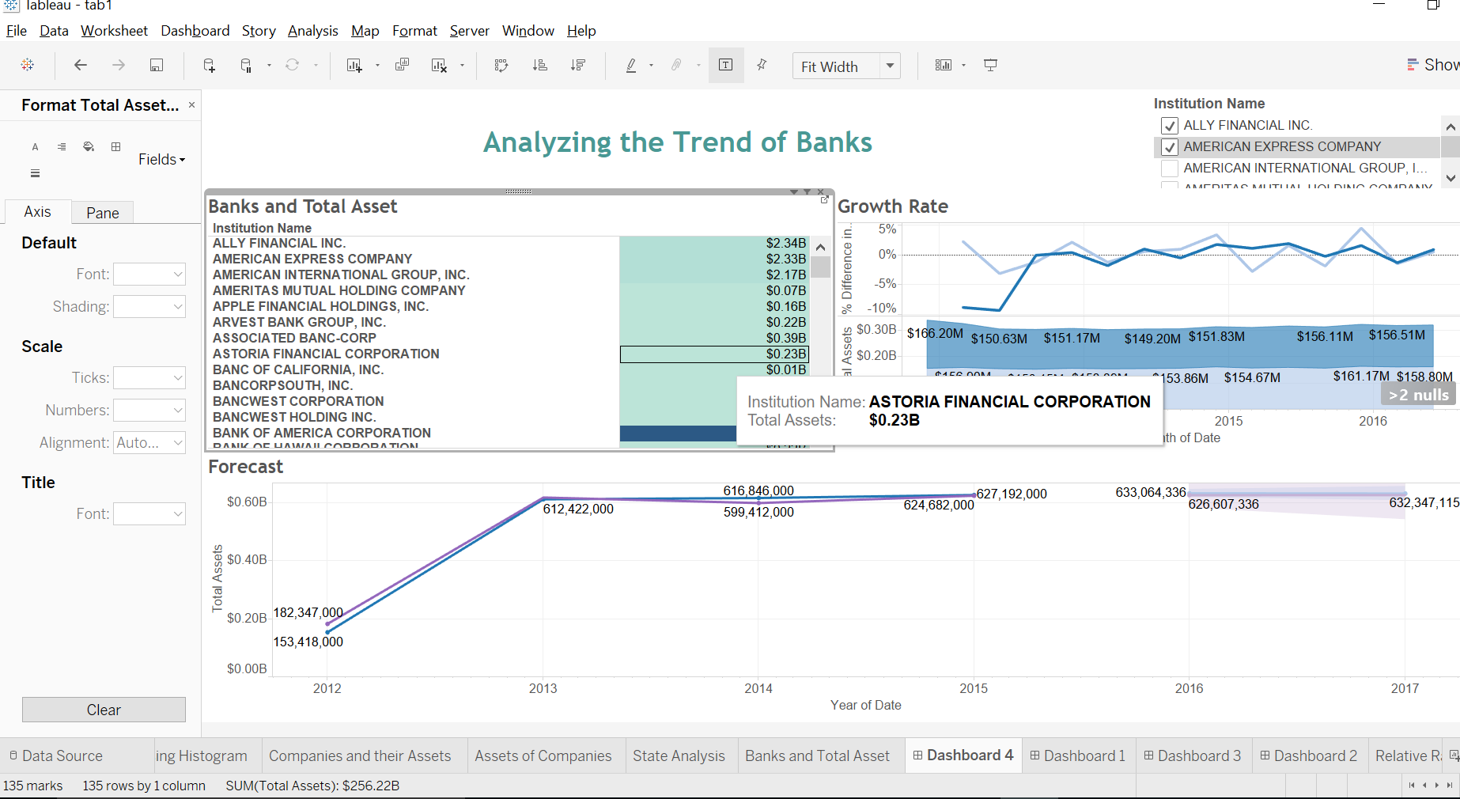
Trend Analysis and Forecasting
Getting an insight of the Banks and analyzing the trends year over year and getting the growth rate percentage and forecasting the Future.

Slide 15
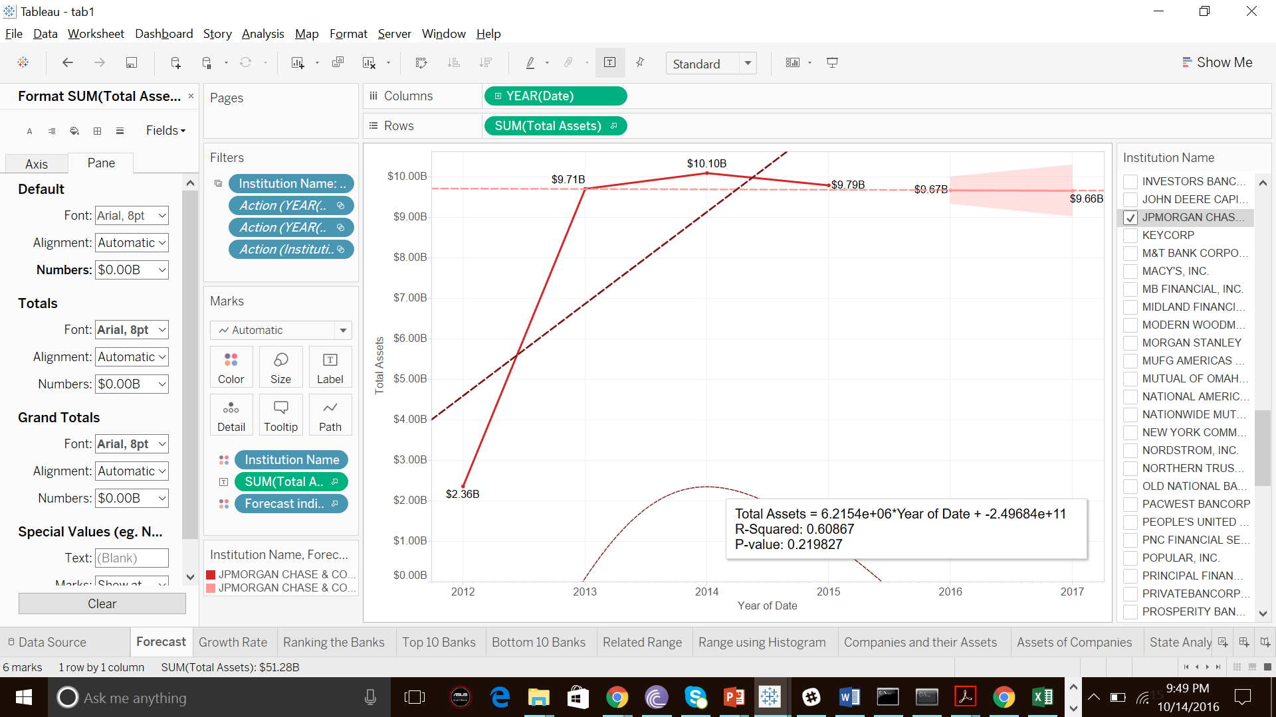
An Insight in the Forecasts
Forecasted the Total asset values of Banks and predicted the asset value of J.P.Morgan to be $9.66B (dropping by 0.11%) in 2017, considering trend over last 5 years.
Same result can be found by applying linear regression over the dataset.

Slide 16
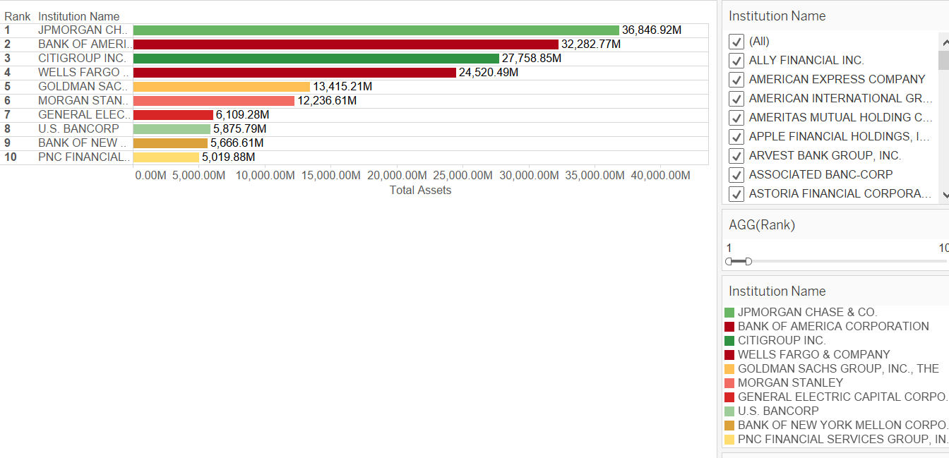
Ranking the Banks
TOP 10 BANKS
JP Morgan chase with the highest assets of 36,846 M.

Slide 17
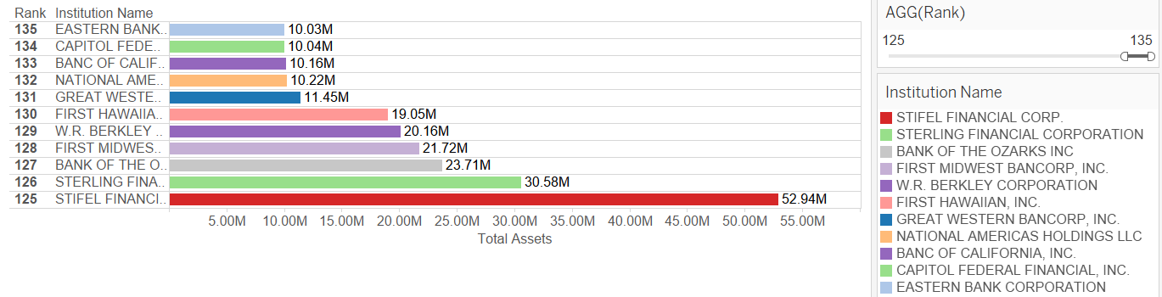
Ranking the Banks from Bottom
The eastern Bank having the least value of around 10M.

Slide 18
Assignment 1 – Part 2
Goals
1. Scrap the website and download PDF files
2. Clean the PDF files and scrap the data from PDF in a clean consistent format
Data Reference: https://www.ffiec.gov/nicpubweb/content/BHCPRRPT/BHCPR_Peer.htm
Coding Language Used: Python
Part 2

Slide 19
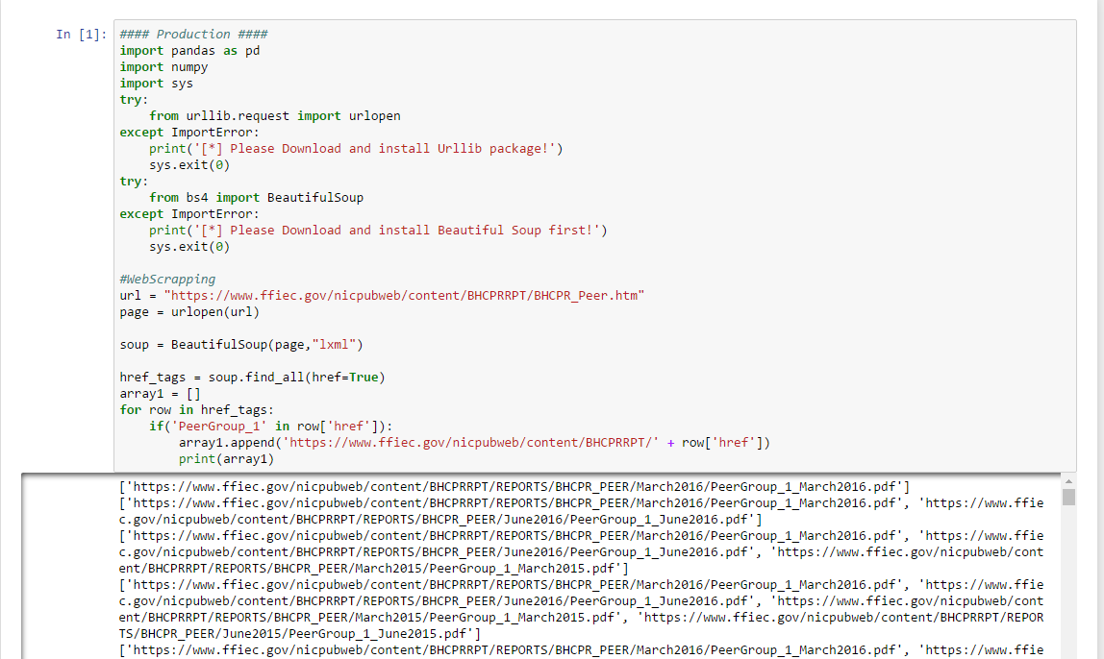
Part 2: Step 1
Fetching HTML content using URLLIB and BeautifulSoup library. Finding all the ‘a’ tag and getting the ‘href’ attribute. Filtering out URL containing a pattern of ‘PeerGroup_1’ in which we are interested
Finding all the ‘a’ tag and getting the ‘href’ attribute. Filtering out URL containing a pattern of ‘PeerGroup_1’ in which we are interested.
Filtered ‘url’ are now kept in the list to be used further

Slide 20
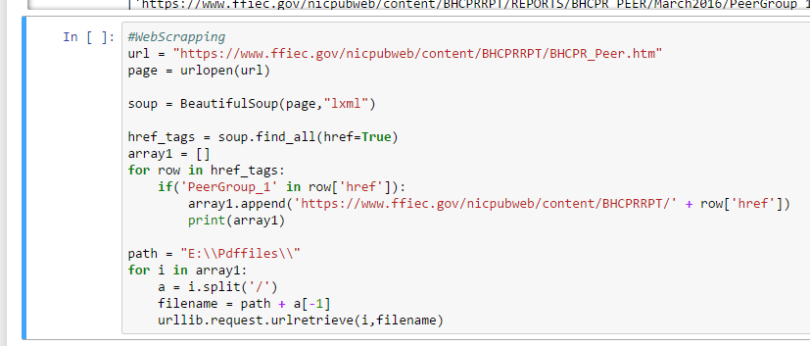
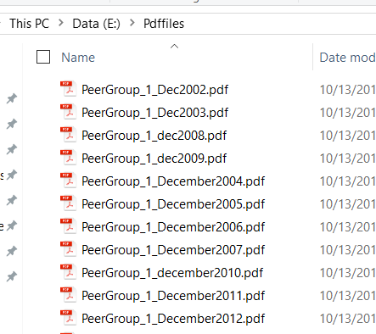
Part 2: Step 2
Using the ‘urlretrive’ function from urllib package, to download the url. Looping through all the url’s in the array and downloading the files in a drive defined in the code

Slide 21
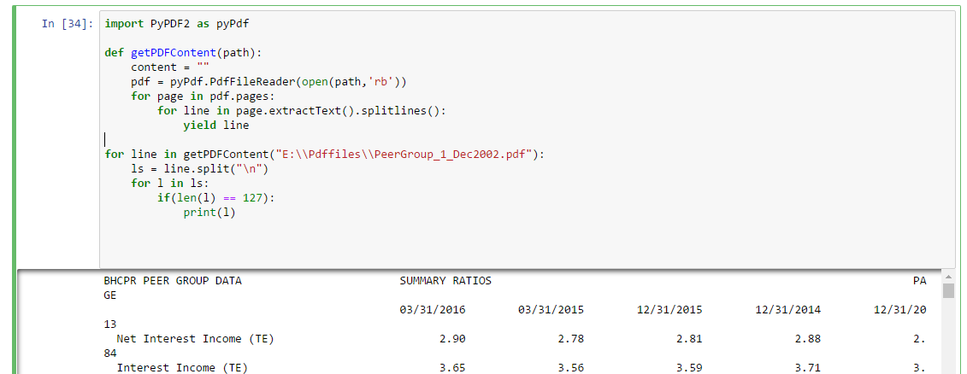
Part 2: Step 3
Using the ‘PyPDF2’ package for Python 3.5 reading the pdf page by page. Defined a function which will take path of the pdf file and extract lines of each page in the pdf. Extracted lines is split by ‘/n’ (break) and printed to see the result

Slide 22
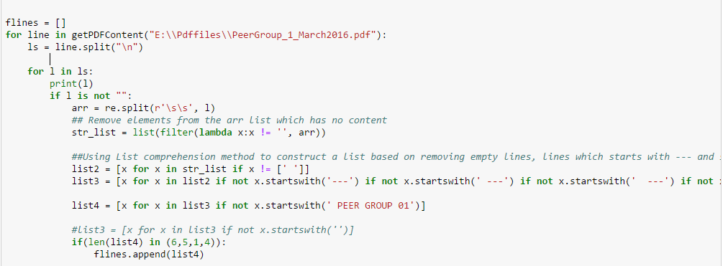
Part 2: Step 4
Applying regex on the lines to remove unwanted data.
Splitting the data in each line by 2 spaces
Applying a function on the splitted data to remove ‘ ‘ (blank) element and appending to a list
Filtering the list further using list comprehension method in python to remove elements with ‘ ‘ or ‘---’ or ‘ ----’ and so on. (can be achieved through regex as well)
After cleaning analyzing the lengths of each list, filtering out list containing 6,5,1,4 elements which is useful
After the cleansing adding into the final list named ‘flines’ here

Slide 23
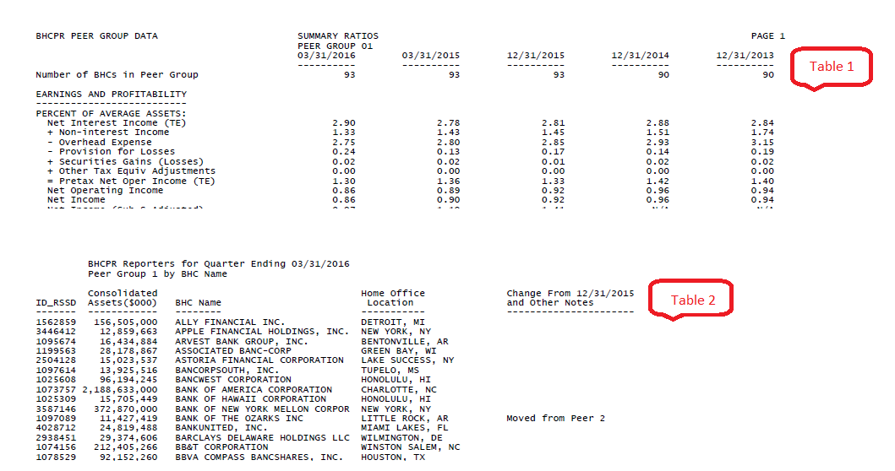
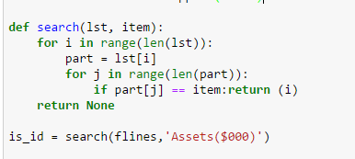
Part 2: Step 5
Since the PDF have two tables with different number of columns. We defined a function to find 2nd table and return the index of the list where it is found in the flines list.

Slide 24
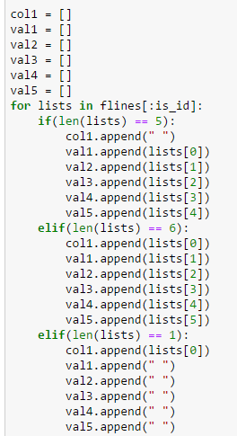
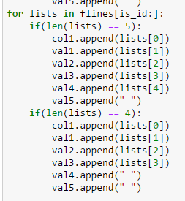
Part 2: Step 6
Looping through the lines in flines array and adding into the arrays to make dataframe. Two loops for two tables, 1 loop ranging from flines[1:is_id] and second in the range of flines[is_id:]
Converting the list into a dataframe as shown below and converting to csv

Slide 25
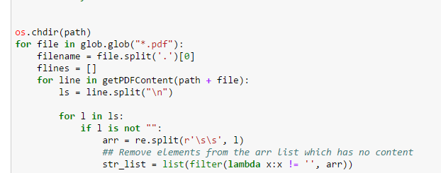
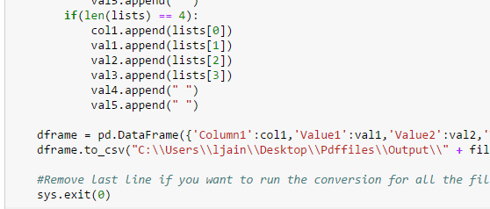
Part 2: Step 7
Looping through all the pdf files and dynamically appending the filenames of the csv

Slide 26
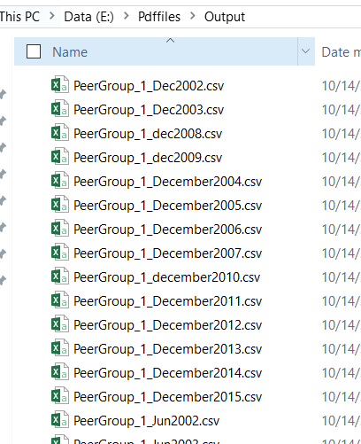
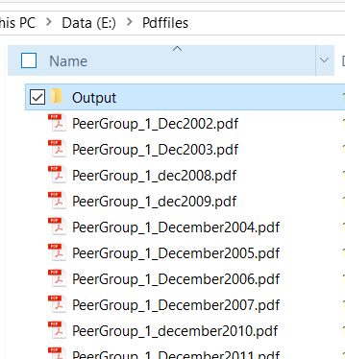
Part 2: Final Output

Slide 27
Assignment 1 – Part 3
Goals
1. Using 2012,2013,2014 (data Indicators, All Line Items), create dashboards in Tableau for the graphs presented in the Graphs and Time Series Sheets
2. Analyze the data using Tableau and find insights
Data Reference: https://www.ffiec.gov/nicpubweb/nicweb/Y15SnapShot.aspx
Reporting Tool: Tableau
Part 3

Slide 28
Introduction about the Data
The FR Y-15 Snapshots page includes the six columns described below.
As-of date: This column provides the as-of date for the data files in the given row.
Indicators: The files listed in this column contain the aggregated measures of systemic importance found on the FR Y-15.
All line items: The files listed in this column contain all of the public FR Y-15 data that were submitted for the given as-of date, including the aggregated measures of systemic importance captured in the indicators file.
Other formats: The PDF files listed in this column contain graphs of each aggregated measure of systemic importance captured in the indicators file along with a table showing the underlying data.

Slide 29
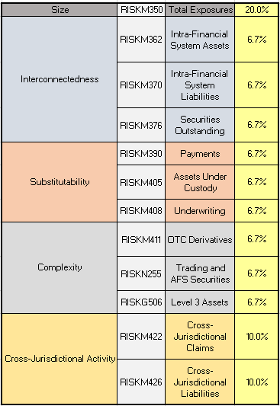
Assessment Indicators
A bank’s score consists of a weighted average of 12 indicators across five categories. Table provides the category, line item number and weight for each indicator.

Slide 30
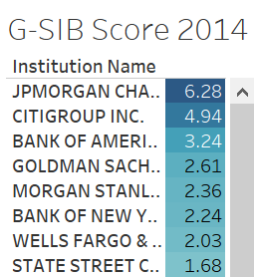
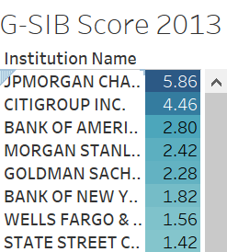
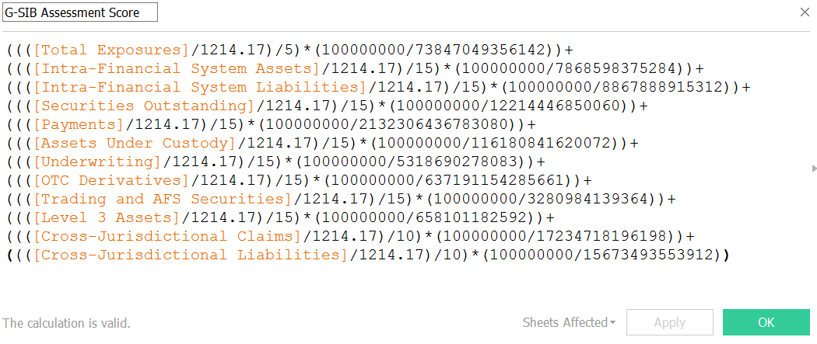
Systemic Score (bps)
Systemic risk scores are based on size, interconnectedness, substitutability, complexity, and cross-jurisdictional activities.
Data must be converted from the reporting currency to euros using the exchange rates, denominators are published on the Committee’s G-SIB webpage. To calculate the scores for the five categories, the scores for the indicators that fall within each category are averaged. The final score is produced by averaging the five category scores.
Formula Used in Tableau

Slide 31
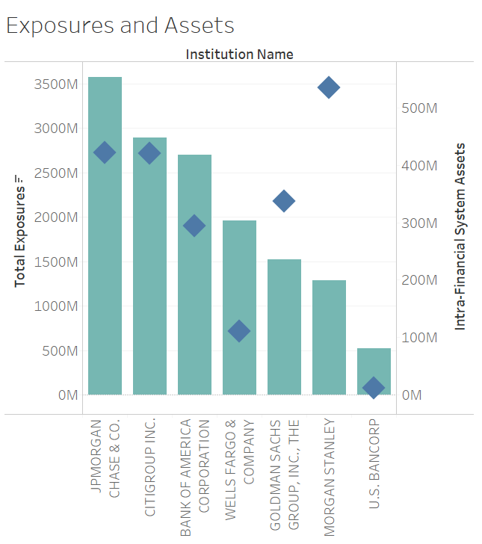
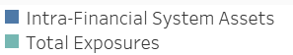
Exposures and Assets
Charts represents two measures of size, total assets and total exposures, the size measure used in the G-SIB methodology that includes derivative positions and securities financing transactions, such as repurchase agreements and securities lending. JPMorgan, Citigroup, BOfA, Wells Fargo have exposure more that the their assets while Goldman Sachs and Morgan Stanley have substantially more Assets than exposure.
In all the years the trend remained pretty much the same, this is 2013 representation.

Slide 32
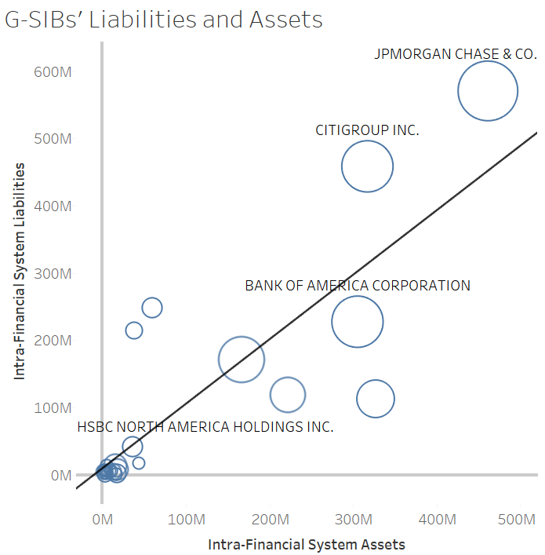
Liabilities vs Assets
Bubble size shows total exposures
The bubble sizes are proportional to each bank’s total exposures. Banks above the diagonal line had net obligations to the financial system, and banks below the diagonal line had net claims on the financial system. Differences in these indicators of interconnectedness partly reflect differences in activities measured by the substitutability and complexity indicators: those above the line generally have large payments activities or assets under custody, while those below the line generally have large trading, derivatives, and underwriting operations.
Net Borrowers
Net Lenders

Slide 33
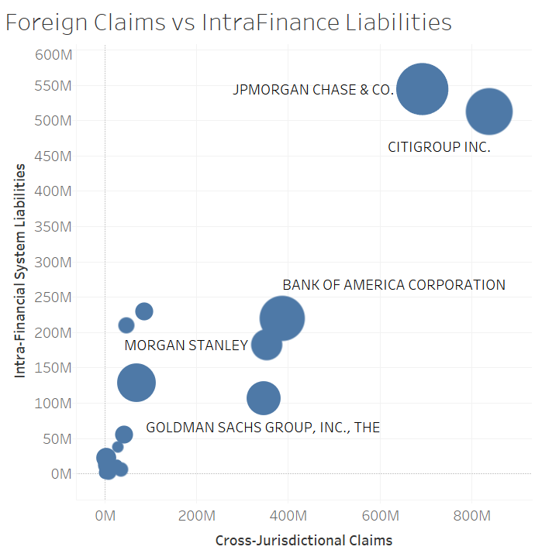
Liabilities vs Assets
Banks with large foreign claims are also highly interconnected to the financial system.
The bubble sizes reflect firm size, based on total exposures. Again, the largest banks are the most interconnected and they are involved in the most cross-jurisdictional activity.

Slide 34
Assessment Methodology
It is “indicator based measurement approach” in determining whether an institution is regarded as a G-SIB. Each of these indicators is given a 20% weighting and, as specified below, most of the indicators are made up of two or more sub-indicators (with each sub-indicator given equal weighting within such category).
For each bank, the score for a particular indicator or sub-indicator is calculated by dividing the relevant amount for that bank in respect of such indicator by the aggregate amount total for all banks in the sample for that indicator.
In the case of sub-indicators, the score is adjusted by the relevant weighting within each category. Each indicator’s score is then aggregated. The maximum possible score (if there were only a single bank in the world) would be 5.

Slide 35
Graphs
The graphs worksheet of the Excel file provides bar graphs for each of the aggregated measures of systemic importance captured in the indicators worksheet. The data used to produce the graphs can be found in the upper right portion of the worksheet.
We have pulled out tableau representation of the parameters and tried to decipher some financial information.

Slide 36
Cross-jurisdictional activity.
This indictor would measure the global footprint of the bank with the aim that the international impact from a bank’s distress or failure should vary in line with its share of cross jurisdictional assets and liabilities. There are two sub-indicators for this category:
Cross-jurisdictional claims: It is proposed that this sub-indicator uses the same data used to calculate international banks’ activities outside their home jurisdiction by the Bank for International Settlements (“BIS”).
Cross-jurisdictional liabilities: This sub-indicator would use the same BIS data referred to above and combine figures reported as part of the local banking statistics for the bank’s home jurisdiction with its consolidated statistics. The calculation will take into account the liabilities of all offices of the relevant bank to entities outside the home market and include all liabilities to non-residents of its home jurisdiction.

Slide 37
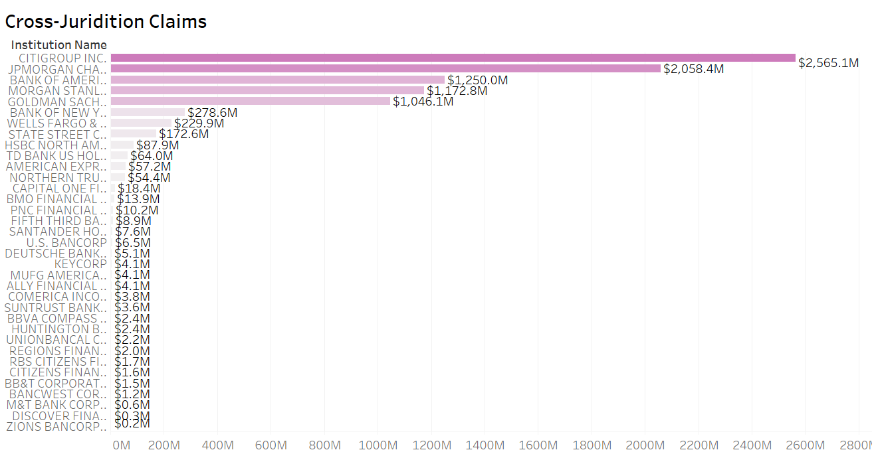

Slide 38
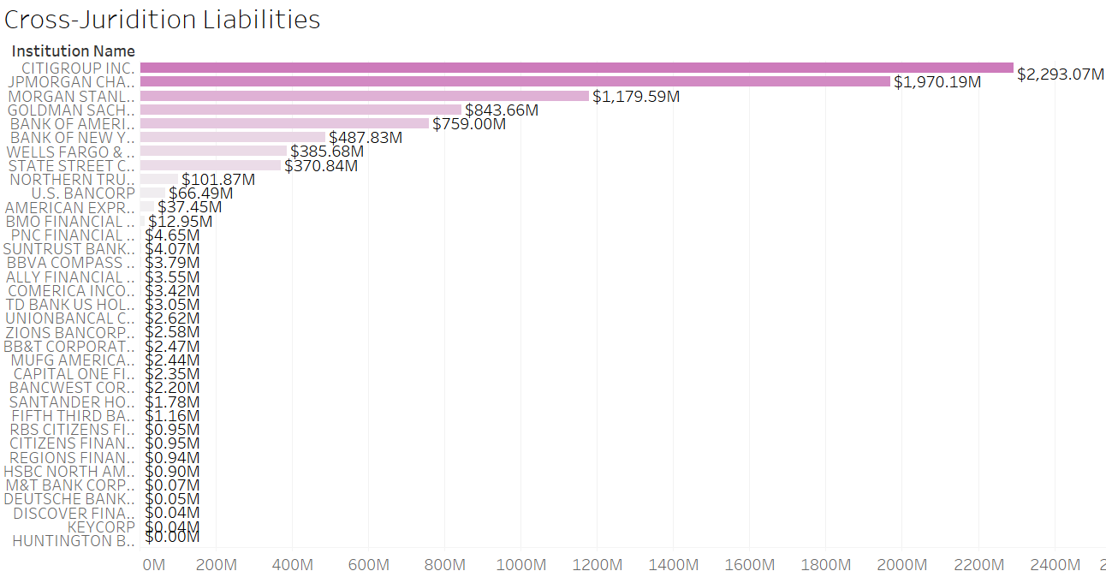

Slide 39
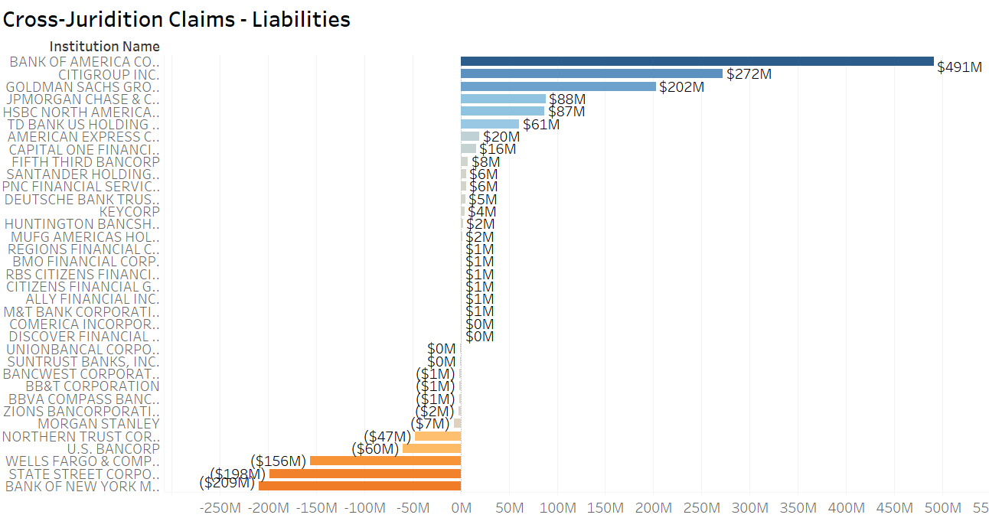

Slide 40
Size
Size will be included as an indicator on the basis that a bank’s distress or failure is more likely to damage the global economy or financial markets if its activities comprise a large share of global activity. The BCBS states that the larger the bank, the more difficult it is for its activities to be replaced by other banks in the event of its failure. Its failure is therefore more likely to damage confidence in the global financial system. It is proposed that there will be only a single indicator for size using the same definition for total exposures of a bank in calculating its leverage ratio.

Slide 41
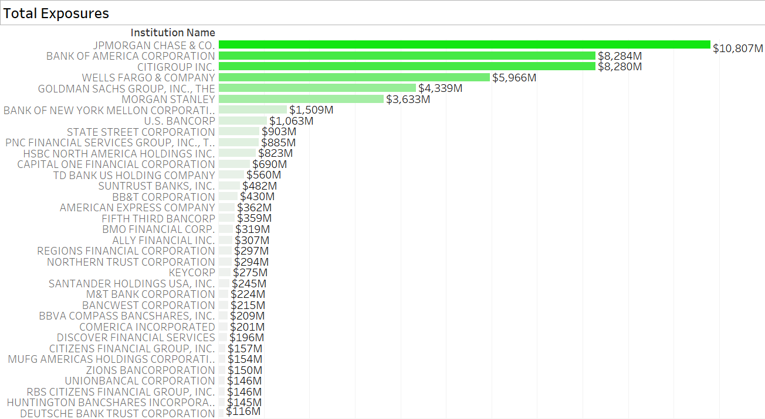

Slide 42
Interconnectedness
Financial distress at an institution can materially raise the likelihood of contagion in respect of other institutions depending on the network of contractual obligations in which it operates. This indicator is made up of three sub-indicators:
Intra-financial system asset: The sum of (i) lending to financial institutions (including undrawn commitments), (ii) holdings of securities issued by other financial institutions, (iii) net mark to market reverse repos, (iv) net mark to market securities lending to other financial institutions, and (v) net mark to market OTC derivatives with financial institutions.
Intra-financial system liabilities: The sum of (i) deposits by financial institutions at the relevant bank, (ii) securities issued by the bank owned by other financial institutions and liabilities of the nature specified under (iii) to (v) of intra-financial system assets above.

Slide 43
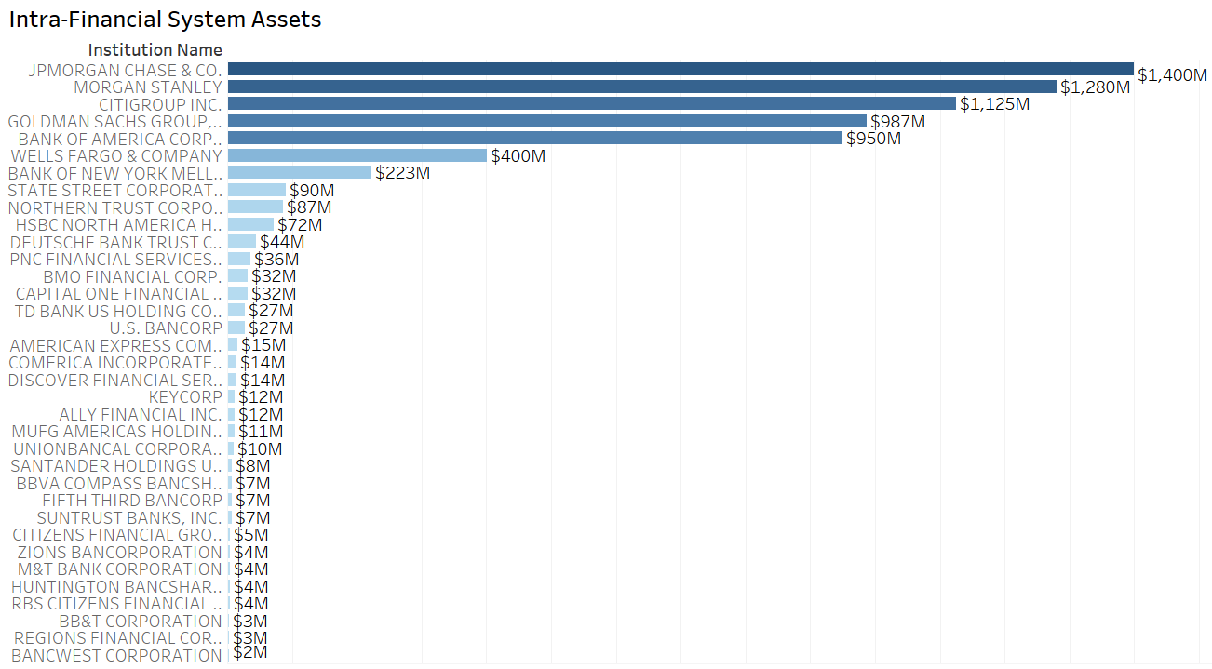

Slide 44
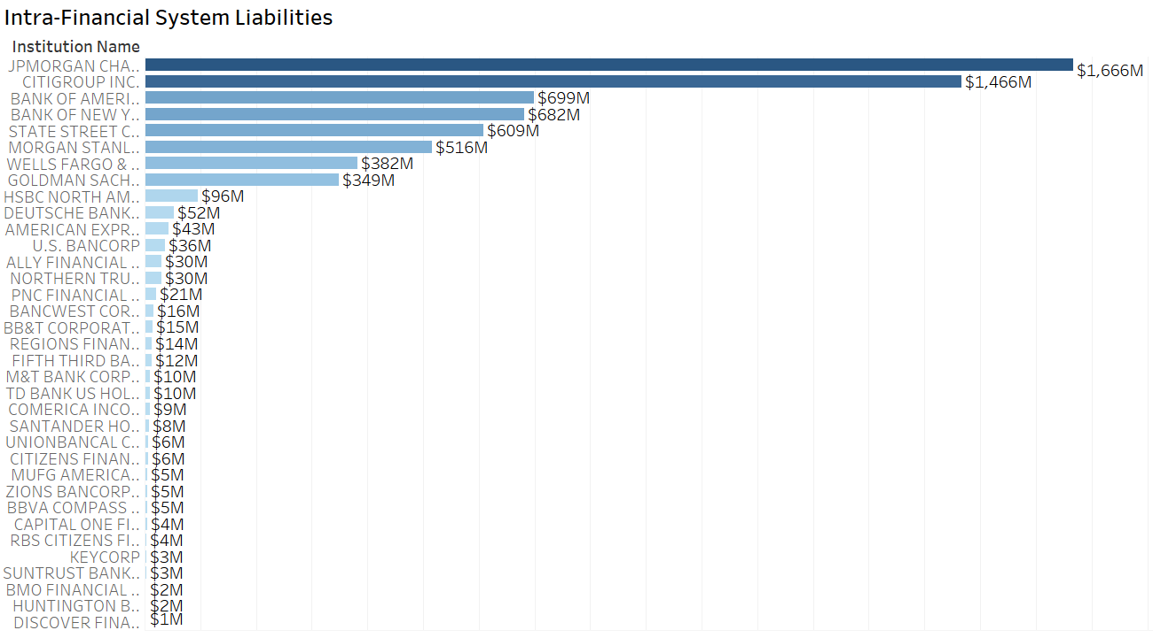

Slide 45
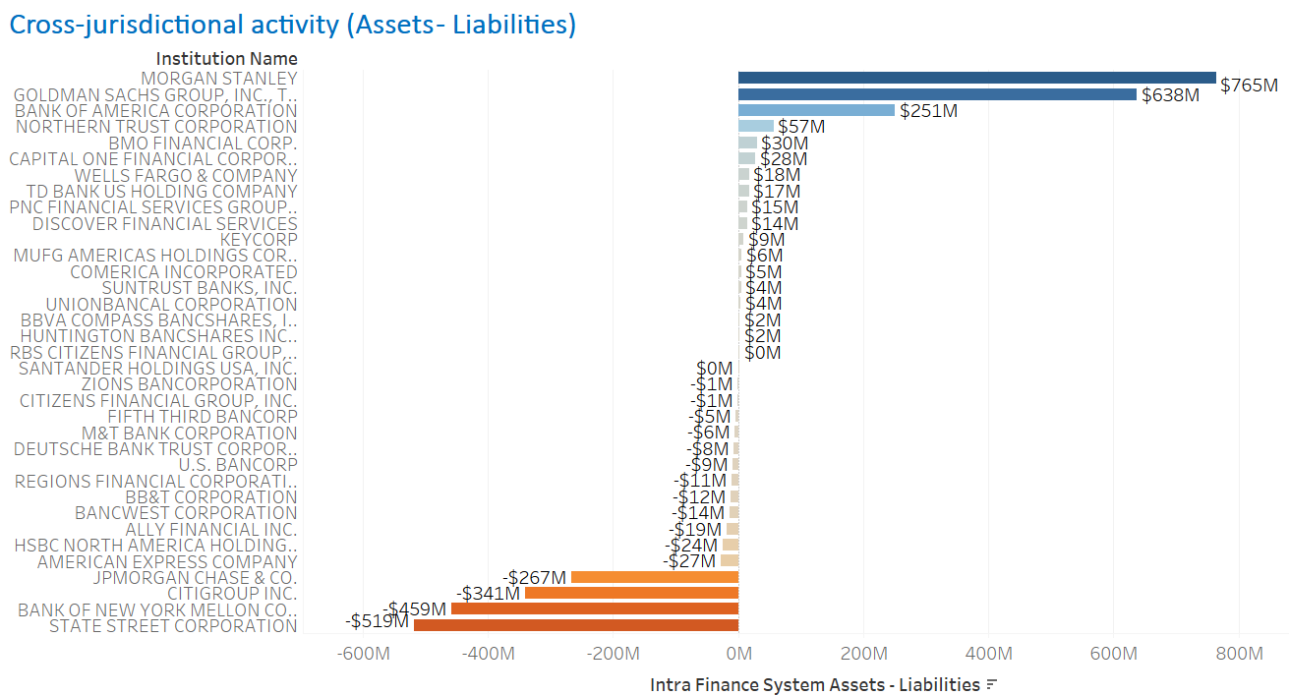

Slide 46
Substitutability
Systemic impact of a bank’s distress or failure is expected to be negatively related to the substitutability of its services. Where there is a lack of realistic alternatives to a major business line or service of the bank, the greater the effect its failure is likely to cause. It is also noted that the cost to the failed bank’s customers in having to seek the same service at another institution is likely to be higher for a failed bank with a large market share in respect of the relevant service. There are three sub-indicators:
Assets under custody: The BCBS notes that the failure of a large custodian bank holding client assets could disrupt the operation of financial markets, and this indicator is the value of assets that a bank holds as a custodian divided by the sum total reported by the banks in the sample.
Payments cleared and settled through payment systems: The BCBS concludes that a bank which is involved in a large volume of payments is likely to act on behalf of a large number of other institutions and customers including retail customers. If it were to fail, these institutions and customers may be unable to process payments immediately, affecting their liquidity. This sub-indicator is calculated as the value of a bank’s payments sent through all of the main payment systems of which it is a member divided by the total reported by all the banks in the sample.
Value of underwritten transactions in debt and equity markets. The BCBS states that the failure of a bank with a large share of debt and equity underwriting in the global markets may significantly impede new securities issuance. The indicator is calculated as the annual value of debt and equity instruments underwritten by the bank divided by the aggregate figure for all the banks in the sample.

Slide 47
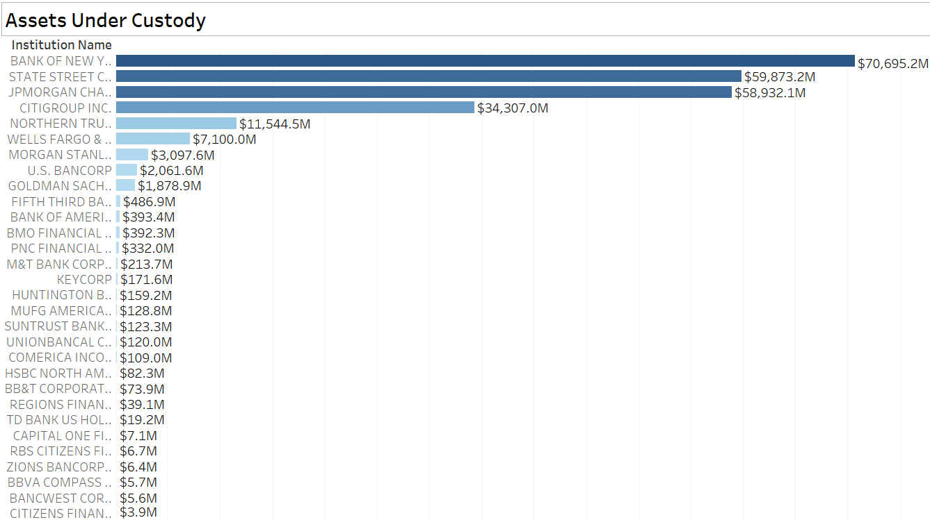

Slide 48
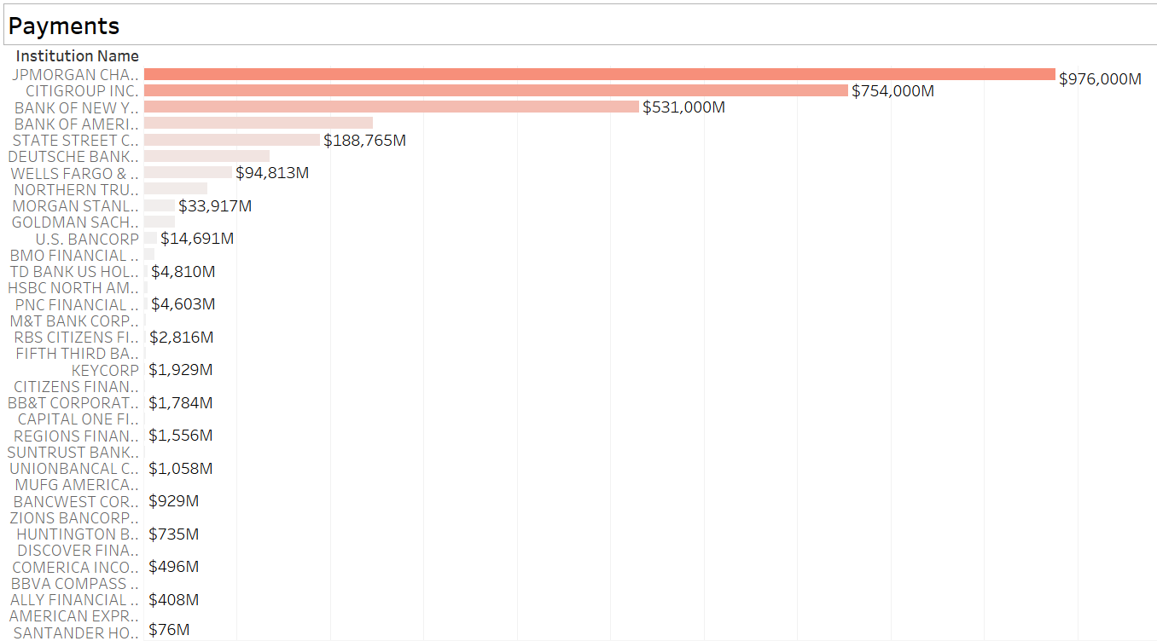

Slide 49
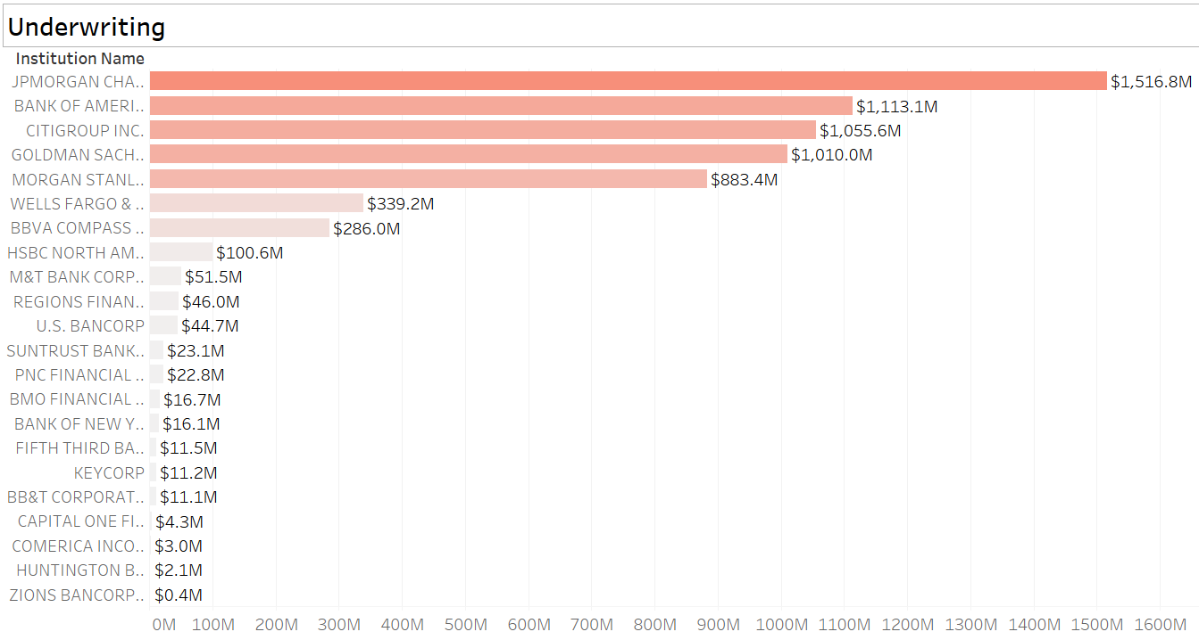

Slide 50
Complexity
Systemic impact of a bank’s distress or failure is likely to be greater, the more complex its business, structure, and operations are. It specifies sub-indicators:
OTC derivatives: The calculation is made by reference to the gross nominal or notional value of all OTC derivatives not cleared through a central counterparty and not settled at the reporting date.
Level 3 assets: These are defined as assets whose fair value cannot be determined using observable measures (such as market prices or models) and are therefore illiquid. The indicator for each bank is calculated as the ratio of its reported value of level 3 assets and the aggregate of such values reported by all banks in the sample.
Trading book value and “available for sale” value: The BCBS states that banks holding financial securities in the trading book and “available for sale” securities are vulnerable to mark to market losses and subsequent fire sales of the securities in situations of financial stress. This can drive down the price of such securities leading to the write-down in the value of the same securities held by other institutions. This sub-indicator is calculated as the ratio of the total value of the banks’ holding of securities in the trading book and available for sale securities to the total value of such securities held by banks in the sample.

Slide 51
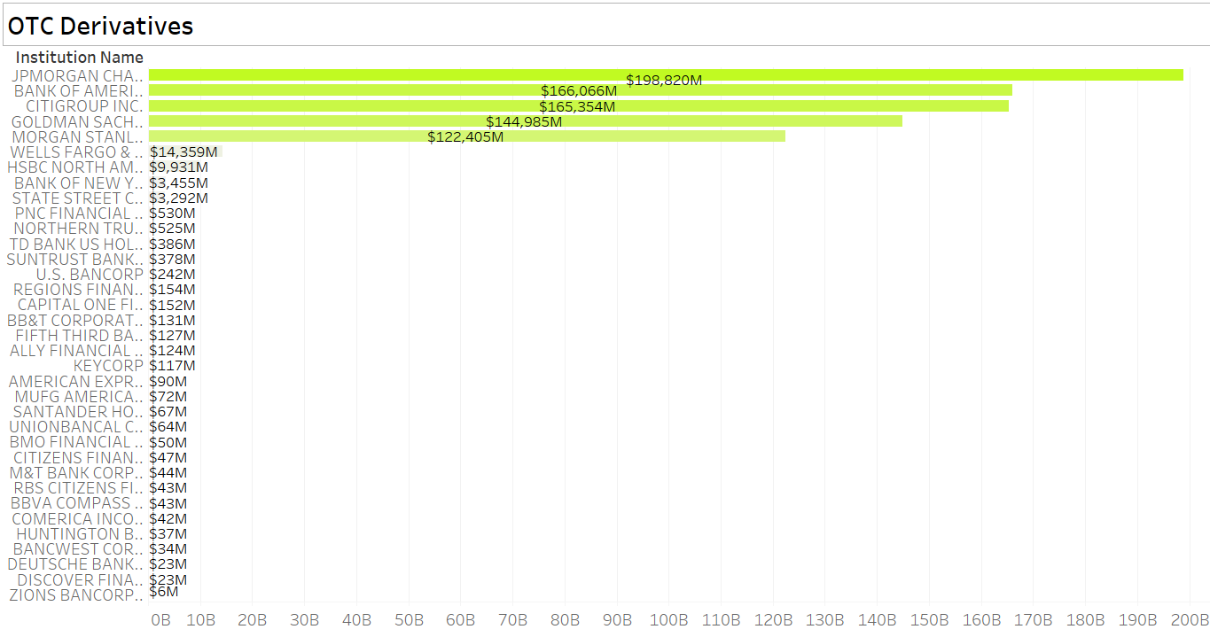

Slide 52


Slide 53


Slide 54
Time series charts
We have shown percentage change of the Indicators data during 2013 to 2014, the charts are sorted to show which institutions have deviation in indicators

Slide 55


Slide 56


Slide 57


Slide 58


Slide 59


Slide 60


Slide 61


Slide 62


